Slide 1


CSI 1430 - Professor John
PRACTICUM PASSERS: GROUP PROJECT N4.G3
Present by Nolan Schirripa, Christine Seng, Erick Martinez, Georgia Rushing, Graham Balas

Slide 2

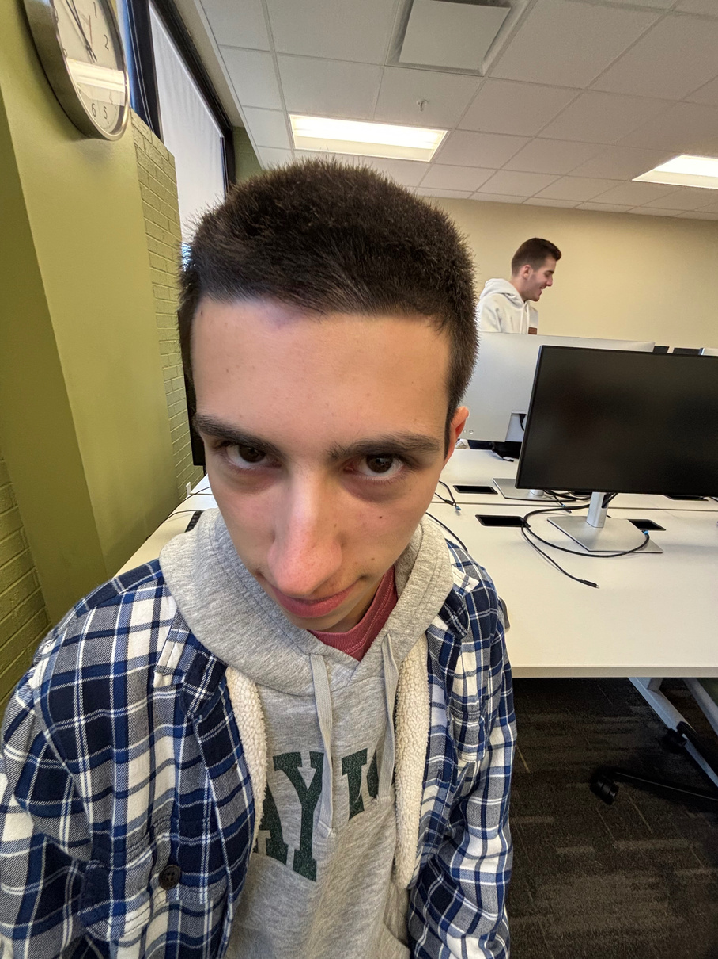
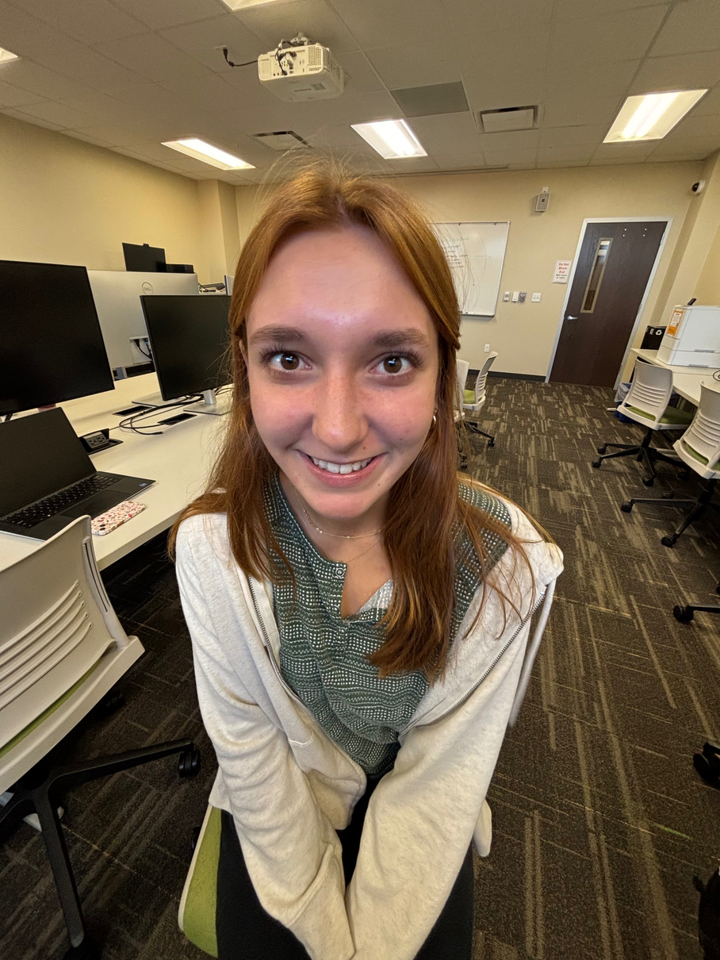
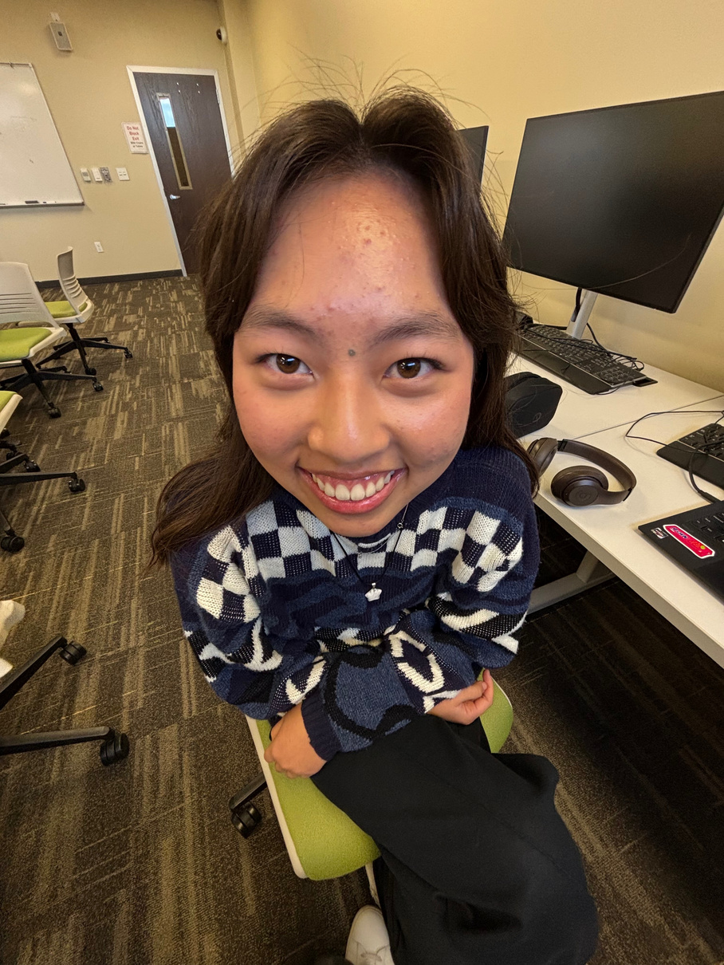
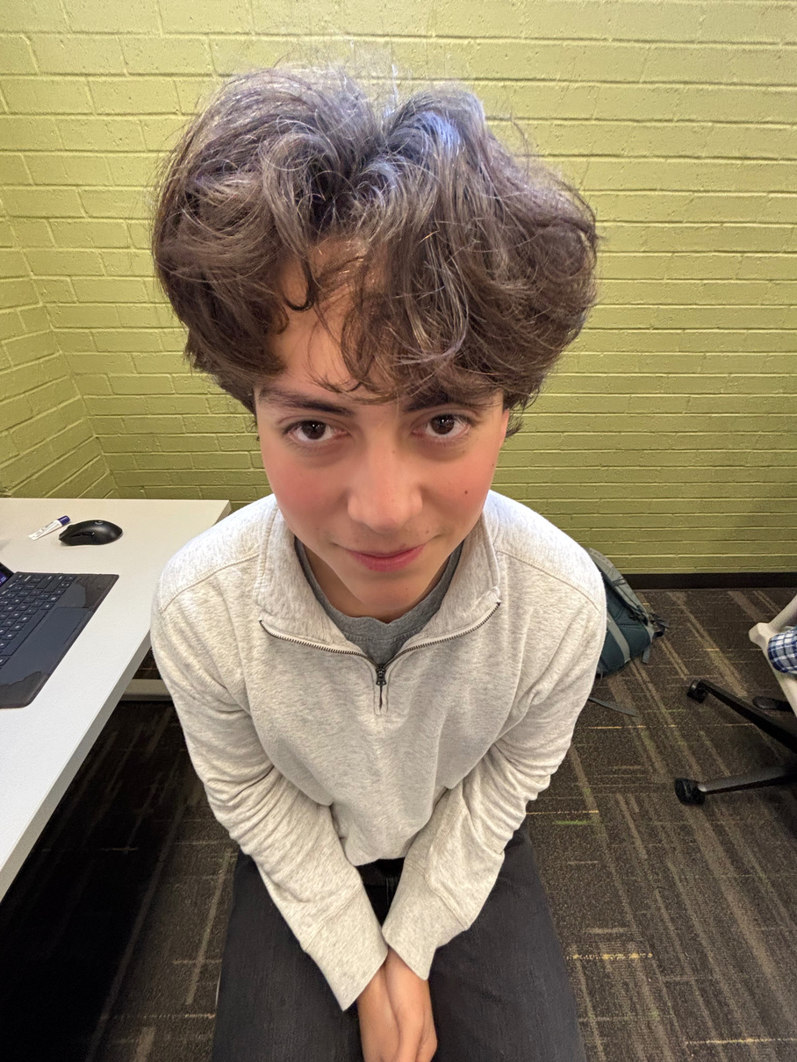
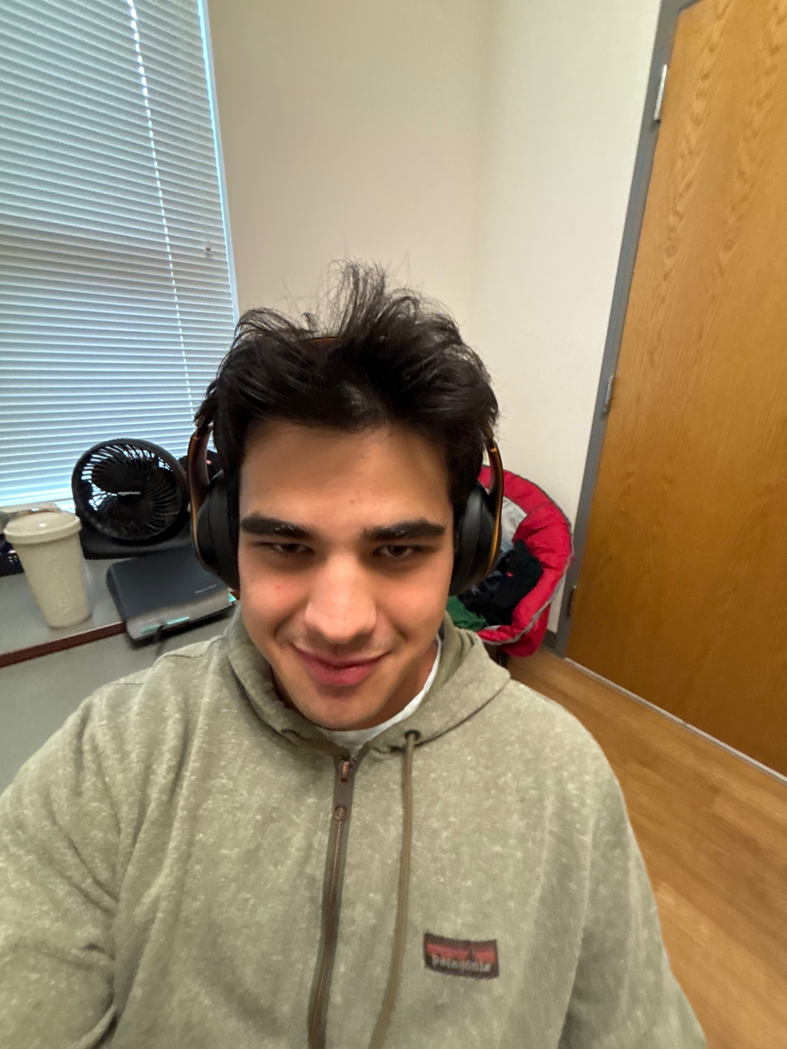
MEET THE TEAM!
NOLAN SCHIRRIPA
GEORGIA RUSHING
CHRISTINE SENG
ERICK MARTINEZ
GRAHAM BALAS
Block Master
Text Savant
Jedi (Force Expert)
Stage Sage
Janitor (Code Cleanup)

Slide 3

CORE
FEATURES

Slide 4
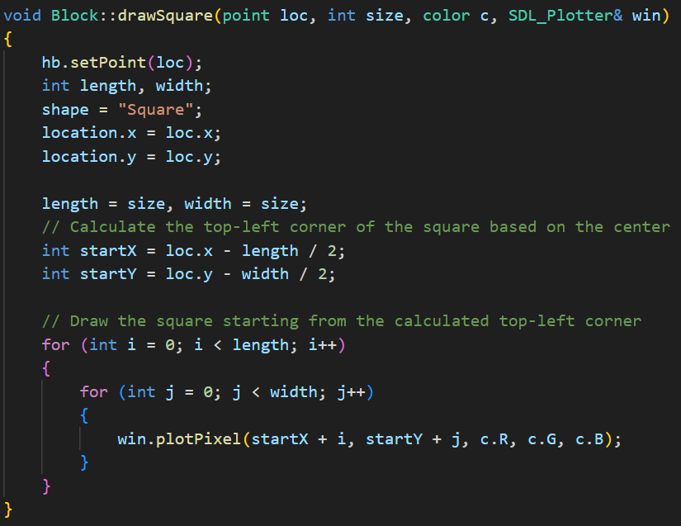
DRAWING
SHAPES (SQUARE)

Slide 5
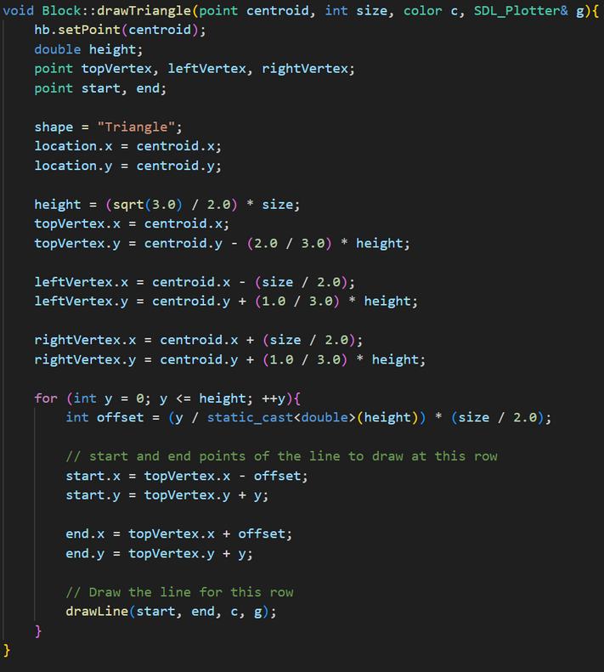
DRAWING
SHAPES (TRIANGLE)

Slide 6
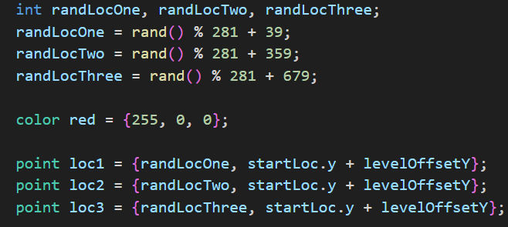
RANDOM BLOCK
LOCATIONS

Slide 7
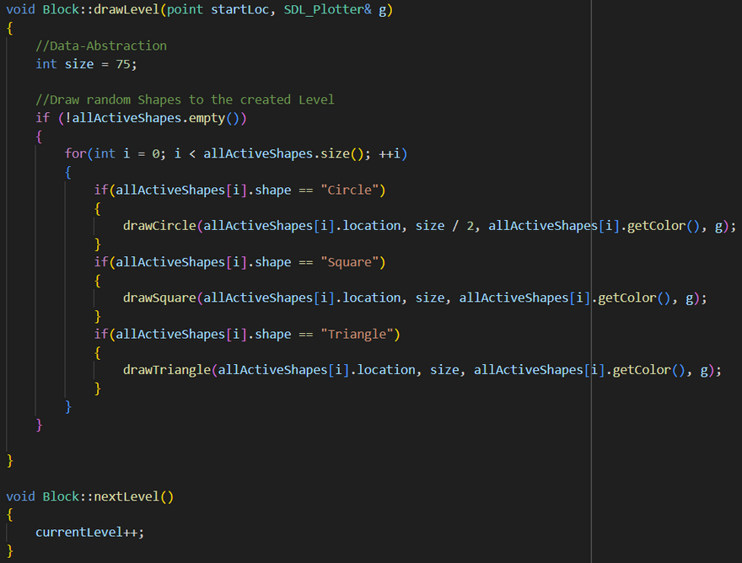
DRAWING
LEVELS

Slide 8
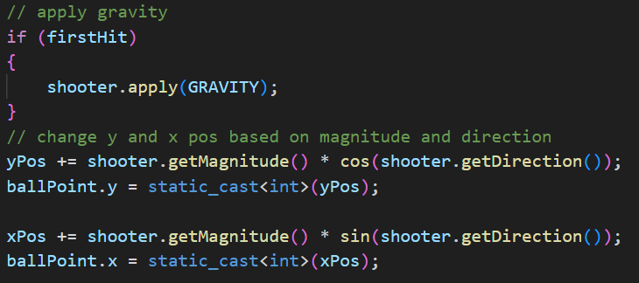
BALL PHYSICS (FALLING)

Slide 9
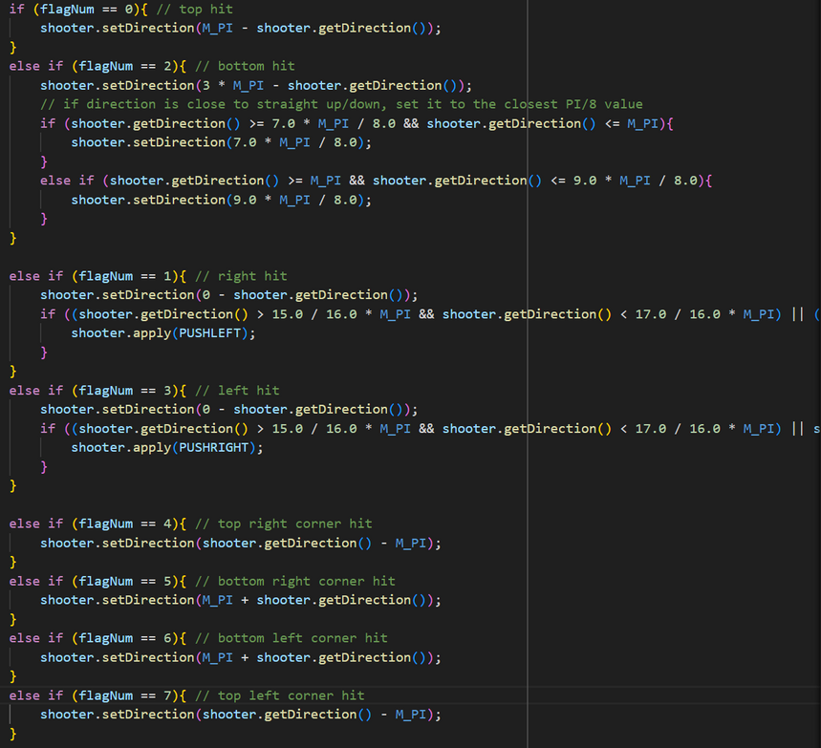
BALL PHYSICS (BOUNCING)

Slide 10
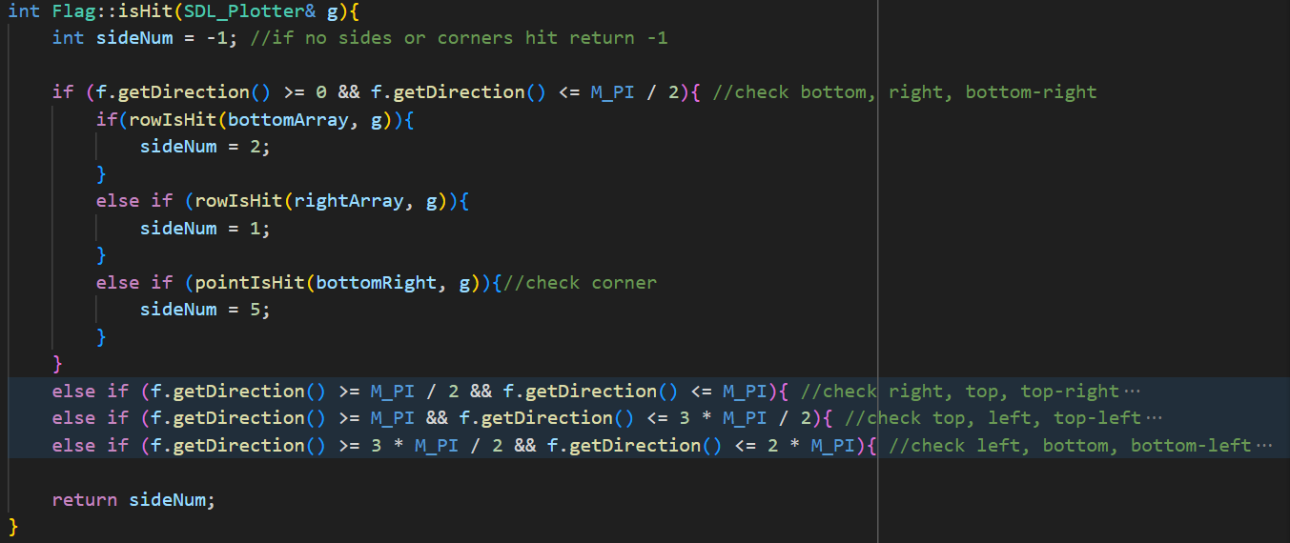
BALL + BLOCK
COLLISIONS (FLAGS)

Slide 11
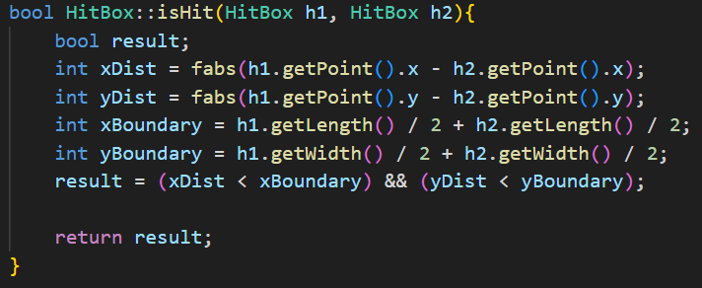
BALL + BLOCK
COLLISIONS (HITBOXES)

Slide 12
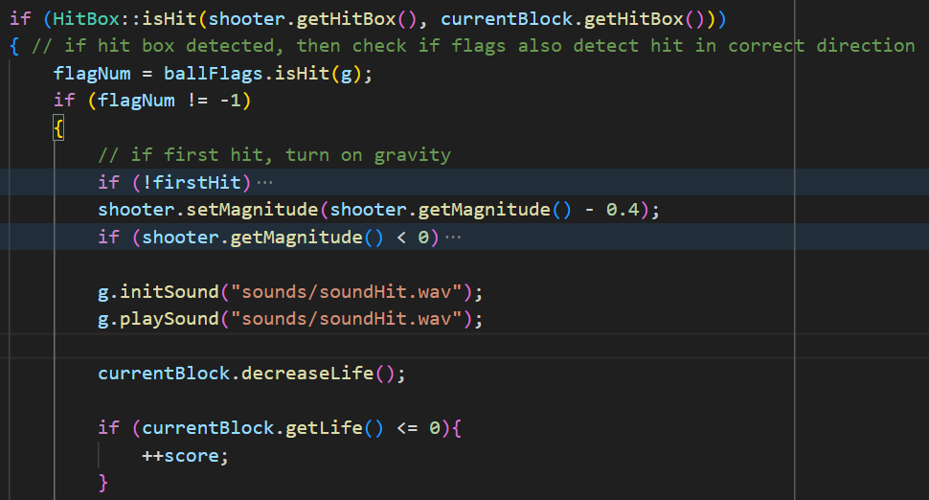
BALL + BLOCK
COLLISIONS (HITBOXES)

Slide 13
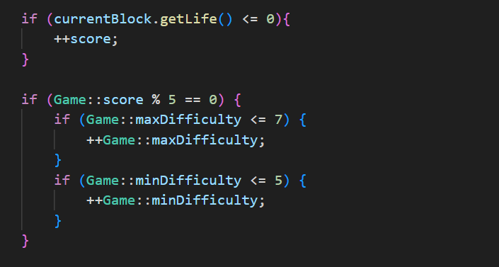
SCORE +
LEVEL DIFFICULTY

Slide 14
ADDITIONAL
FEATURES

Slide 15
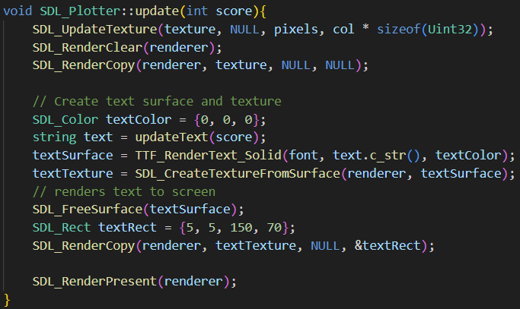
TEXT/TTF
(TRUETYPE FONT)

Slide 16
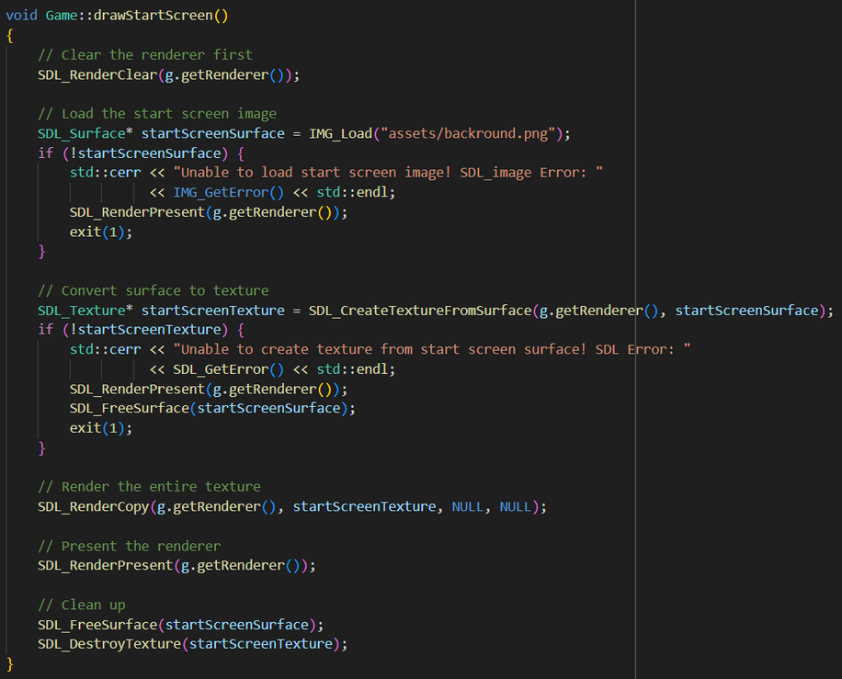
IMAGES
(SDL IMAGE)

Slide 17
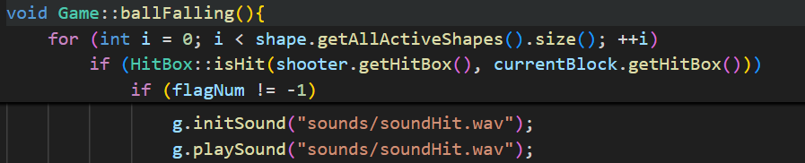
SOUNDS
(SDL MIXER)

Slide 18
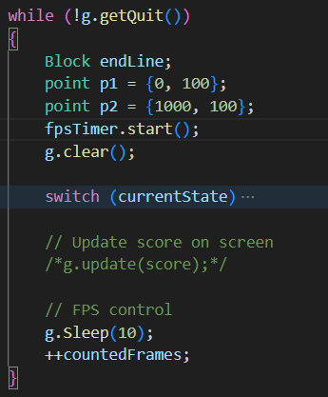
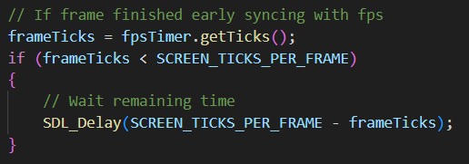
FPS

Slide 19
QUESTIONS?

Slide 20
Practicum Passers N4.G3
THANK YOU
for your time and attention!

